Slide 1
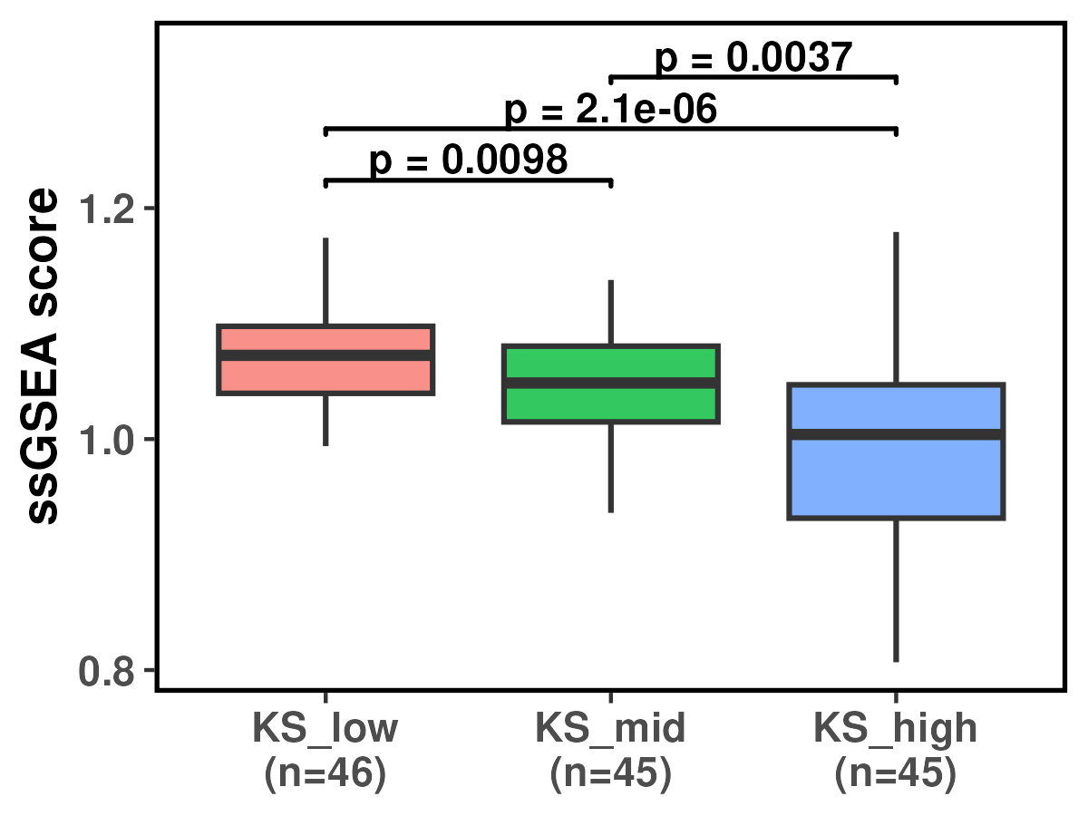
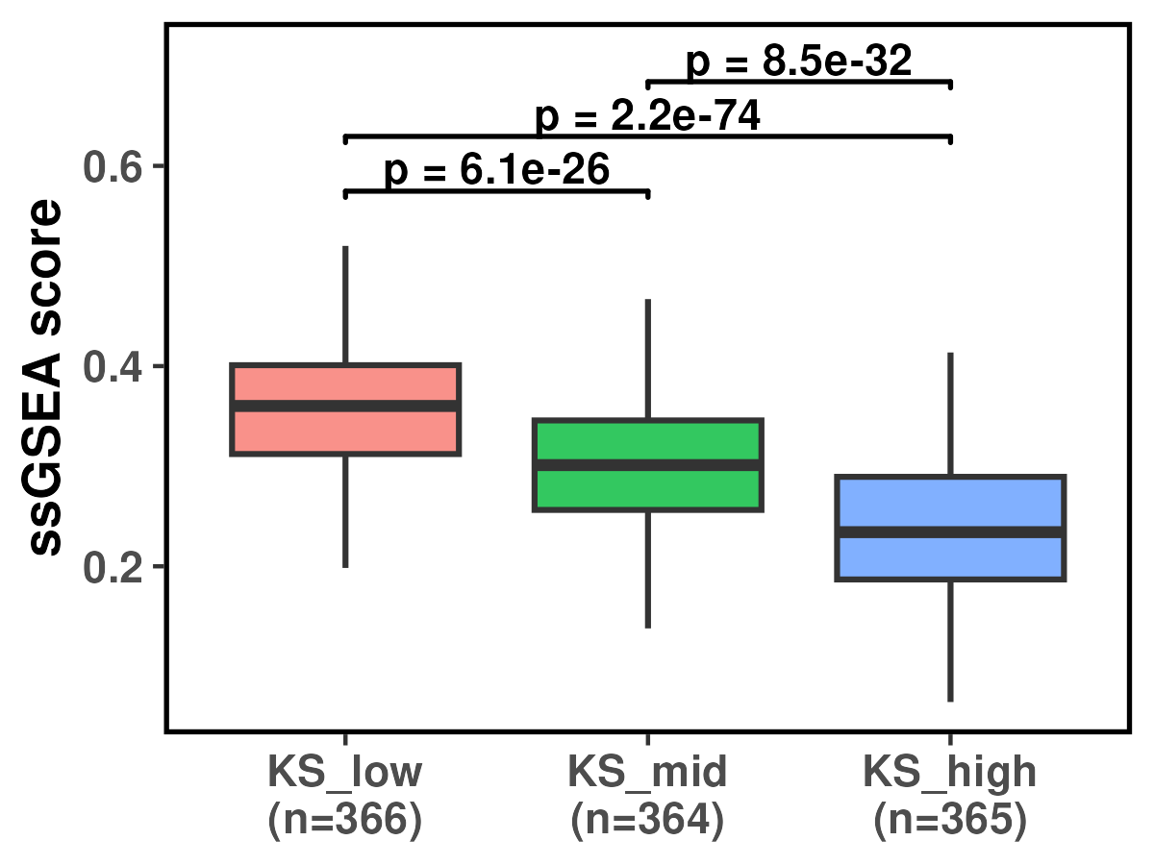
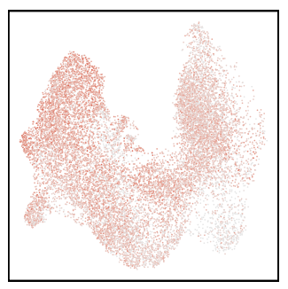

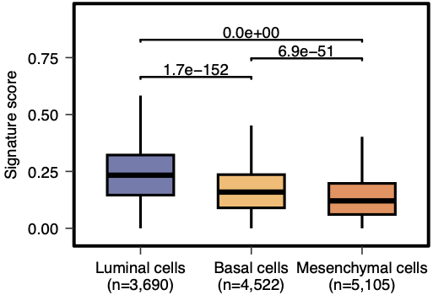
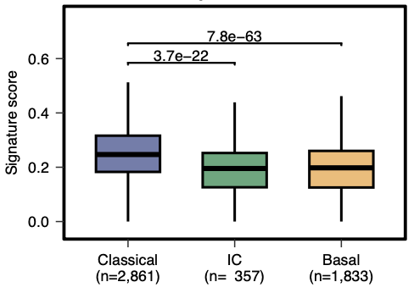
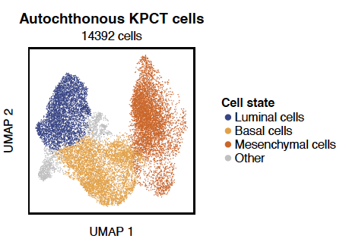
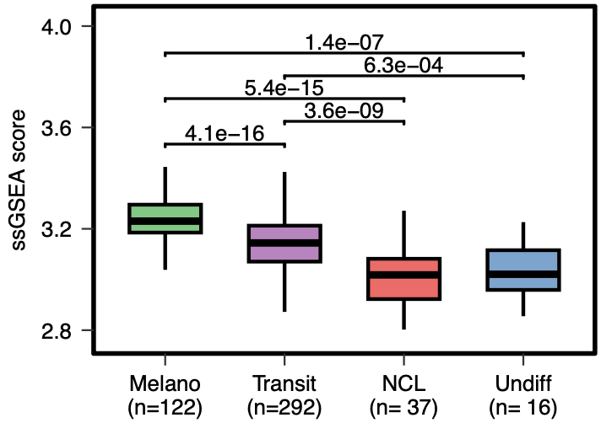
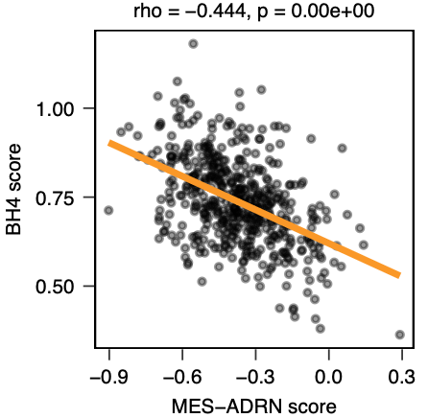
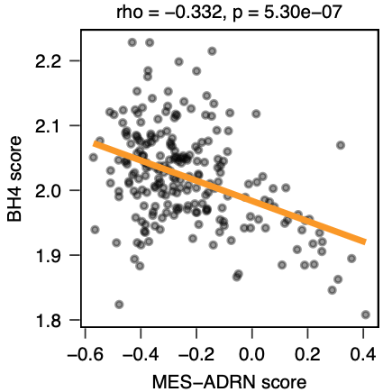
Fig. 5
A
B
Human Breast scRNA-seq
(Chen et al 2026; PMID: 41640877)
C
Human Breast TCGA bulk RNA-seq
(https://www.cancer.gov/tcga)
Differentiated
state(s)
Intermediate
Plasticity associated
state(s)
Dedifferentiated /
mesenchymal-like
state(s)
BH4 pathway transcriptional score
(de novo synthesis & recycling genes)
Human scRNA-seq & bulk transcriptomic data analysis
Breast | PDAC | Melanoma | Neuroblastoma
D
Autochthonous KPCT PDAC scRNA-seq
(Pitter et al 2022; PMID 35952360)
E
Mouse PDAC scRNA-seq
(Pitter et al 2022; PMID 35952360)
F
Human primary PDAC scRNA-seq
(Cohort 1 – Park et al 2024; PMID 38702773)
g
h
Human neuroblastoma bulk
(Cohort 1 – Su et al 2015 / SEQC NB dataset)
i
Human neuroblastoma bulk
(Cohort 2 – Beale et al 2025 / Treehouse dataset)
Human melanoma TCGA bulk
(using 4-state trajectory from Tsoi 2018;PMID 29657129)
498 samples
221 samples

